Slide 1

.
ICU ZAMBIA
Mr Kaela Kamweneshe
kamweneshek@gmail.com
+260955085692/+260978681285

Slide 2
JULY, 2018
ENVIRONMENTAL
CHEMISTRY
.

Slide 3
Course Outline:
TOPIC 1: CHAPTER 1: INTRODUCTION TO ENVIRONMENTAL CHEMISTRY 1 Chemistry and Environmental Chemistry 2 The Building Blocks of Matter 3 Chemical Bonds, Compound Formation and Octet Rule
TOPIC 2: CHAPTER 2: ACIDS, BASES, AND SALTS 1 The Importance and nature of Acids, Bases, and Salts 2 Dissociation of Acids and Bases in Water 3 pH and the Relationship Between Hydrogen Ion and Hydroxide Ion Concentrations 4 Preparation of Acids, Bases and Salts
WEEK 3:
TOPIC 3: CHAPTER 3: SOLUTIONS 1 The Solution Process, Solubility and Concentration 2 Standard Solutions and Titrations 3 Solution Equilibria 4 Colloidal Suspensions Onlines Sources

Slide 4
Course Outline : contn.
WEEK 4:
TOPIC: 4) CHAPTER 4: ENVIRONMENTAL CHEMISTRY OF WATER 1 Aquatic Chemistry 2 Metal Ions and Calcium in Water 3 Oxidation-Reduction - Complexation and Chelation and Water Interactions with Other Phases
WEEK 5:
TOPIC 5: CHAPTER 5: WATER POLLUTION 1 Nature and Types of Water Pollutants 2 Elemental Pollutants, Heavy Metal, Metalloid 3 Organically Bound Metals and Metalloids
WEEK 6:
TOPIC 6: CHAPTER 5: WATER POLLUTION 4 Inorganic Species 5 Oxygen, Oxidants, and Reductants 6 Organic Pollutants, Pesticides in Water and Polychlorinated Biphenyls

Slide 5
Course Outline : contn.
TOPIC 6: CHAPTER 6: THE ATMOSPHERE AND ATMOSPHERIC CHEMISTRY 1 The Atmosphere and Atmospheric Chemistry 2 Physical Characteristics of the Atmosphere 3 Energy Transfer in the Atmosphere 4 Atmospheric Mass Transfer, Meteorology, and Weather
TOPIC 6: CHAPTER 6: THE ATMOSPHERE AND ATMOSPHERIC CHEMISTRY
5 Inversions and Air Pollution 6 Chemical and Photochemical Reactions in the Atmosphere 7 Acid–Base Reactions in the Atmosphere 8 Reactions of Atmospheric Oxygen and Nitrogen

Slide 6
Course Outline : contn.
WEEK 9:
TOPIC: CHAPTER 7: SOIL ENVIRONMENTAL CHEMISTRY 1 Nature and Composition of Soil 2 Acid-Base and Ion Exchange Reactions in Soils 3 Macronutrients and Micronutrients in Soil
WEEK 10:
TOPIC: CHAPTER 7: SOIL ENVIRONMENTAL CHEMISTRY 4 Fertilizers 5 Wastes and Pollutants in Soil 6 Soil Loss and Degradation

Slide 7
Introduction to Environmental Chemistry
It means different things to different people. No precise definition.
It is clear that environmental chemists are playing their part in the big environmental issues—stratospheric ozone (O3) depletion, global warming and the like.
Similarly, the role of environmental chemistry in regional-scale and local problems—for example, the effects of acid rain or contamination of water resources—is well established.
There is a clear link in our minds between environmental chemistry and human beings.
For many people, ‘environmental chemistry’ is implicitly linked to ‘pollution’.

Slide 8
ATMOSPHERIC CHEMISTRY
The atmosphere is in the news! Atmospheric chemistry has become a matter of public concern in the last two decades.
While the complexities of modern science do not usually spark off great political and social debate, the changes in the atmosphere have evoked great interest.
Heads of state have been forced to meetings in Stockholm, Montreal, Kyoto and Johannesburg and given their attention to the fate of our atmosphere.
Television, which normally relegates scientific matters to off-peak hours, has shown skilfully created colourful images from remotely sensed measurements of the ozone (O3) hole and huge emissions from forest fires of 1997 that have continued to raise concern into the current century.
What has caused this interest in the atmosphere?

Slide 9
.
The atmosphere is the smallest of the Earth’s geological reservoirs .
It is this limited size that makes the atmosphere potentially so vulnerable to contamination.
Even the addition of a small amount of material can lead to significant changes in the way the atmosphere behaves.

Slide 10
.
We should note that the mixing time of the atmosphere is very rapid.
Debris from a large accident, such as the one at the nuclear reactor at Chernobyl in 1986, can quickly be detected all over the globe.
Pollutant particles from Europe and North America can be detected over China.
This mixing, while distributing contaminants widely, dilutes them at the same time.
By contrast, the spread of contaminants in the ocean is much slower and in the other reservoirs of the Earth takes place only over geological timescales of millions of years

Slide 11
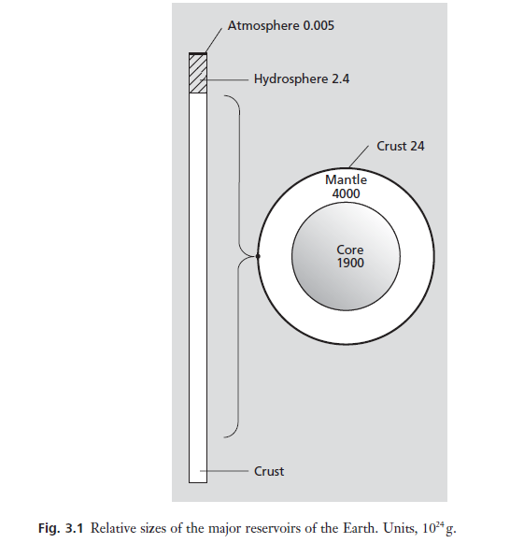
Relative Sizes of Major Reservoirs of the Earth

Slide 12
Composition of the atmosphere.
Bulk composition of the atmosphere is quite similar all over the Earth because of the high degree of mixing within the atmosphere.
This mixing is driven in a horizontal sense by the rotation of the Earth.
Vertical mixing is largely the product of heating of the surface of the Earth by incoming solar radiation.
The oceans have a much slower mixing rate, but even this is sufficient to ensure a relatively constant bulk composition in much the same way as the atmosphere.
However, some parts of the atmosphere are not so well mixed and here quite profound changes in bulk composition are found.

Slide 13
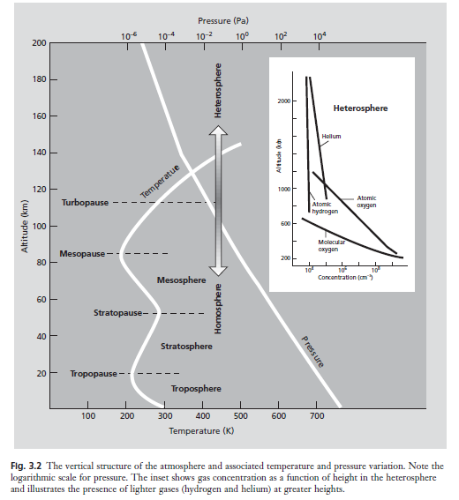
.

Slide 14
The Troposphere
The lower atmosphere, which is termed the troposphere , is well mixed by convection.
Thunderstorms are the most apparent of the convective driving forces.
Temperature declines with height in the troposphere; solar energy heats the surface of the Earth and this in turn heats the directly overlying air, causing the convective mixing.
This is because the warmer air that is in contact with the surface of the Earth is lighter and tends to rise.

Slide 15
The Stratosphere
However, at a height of some 15–25 km, the atmosphere is heated by the absorption of ultra- violet radiation by oxygen (O₂) and Ozone (O₃)
The rise in temperature with height has the effect of giving the upper part of the atmosphere great stability against vertical mixing.
This is because the heavy cold air at the bottom has no tendency to rise.
This region of the atmosphere has air in distinct layers or strata and is thus called the stratosphere.
The well-known O₃ layer forms at these altitudes. Despite this stability, even the stratosphere is well mixed compared with the atmosphere even higher up.

Slide 16
The Heterosphere.
Above about 120 km, turbulent mixing is so weak that individual gas molecules can separate under gravitational settling.
Thus the relative concentrations of atomic oxygen (O) and nitrogen (N) are greatest lower down, while the lighter hydrogen (H) and helium (He) are found to predominate higher up.
Figure below shows the various layers of the atmosphere. The part where gravitational settling occurs is usually termed the heterosphere, because of the varying composition. The better-mixed part of the atmosphere below is called the homosphere.
Turbopause is the term given to the boundary that separates these two parts.
The heterosphere is so high (hundreds of kilometres) that pressure is extremely low, as emphasized by the logarithmic scale in the figure.

Slide 17
.
Vertical air mixing of the atmosphere is largely the product of heating of the surface of the Earth by incoming 1_________.
Horizontal air mixing of the atmosphere is driven by the 2________.
3__________declines with height in the troposphere;
The Atmosphere has five layer namely 4_______________________.
The lower atmosphere, which is termed the 5_______ , is well mixed by convection.
In The Heterosphere, the relative concentrations of 6_____ and 7_______ gases are greatest lower down, while the lighter 8 ______ and 9_____ gases are found to predominate higher up in the atmosphere.

Slide 18
Partial pressure
In a mixture of gases like the troposphere, Dalton’s law of partial pressure is obeyed.
This means that individual gases in the atmosphere will decline in pressure at the same rate as the total pressure.
This can all be conveniently represented by the barometric equation:
p_{z} = p_{o} ^{exp(-z /H)} mm
where p_{z} is the pressure at altitude z, p₀ the pressure at ground level and H, the scale height (about 8.4 km in the lower troposphere and a measure of the rate at which pressure falls with height).

Slide 19
.
We can solve this equation and show that the pressure declines so rapidly in the lower atmosphere that it reaches 50% of its ground level value by 5.8 km.
This is painfully obvious to people who have found themselves exhausted when trying to climb high mountains.
We should note that if equation 3.1 is integrated over the troposphere it accounts for about 90% of all atmospheric gases.

Slide 20
.
The rest are largely in the stratosphere and the low mass of the upper atmosphere reminds us that it will be sensitive to pollutants.
There is so little gas in the stratosphere that relatively small amounts of trace pollutants can have a big impact.
Furthermore, pollutants will be held in relatively well-defined layers because of the restricted vertical mixing and this will prevent dispersal and dilution.

Slide 21
.
It is well known that the atmosphere consists mostly of nitrogen (N₂) and O₂, with a small percentage of argon (Ar).
The concentrations of the major gases are listed in Table 3.1. Water (H₂O) is also an important gas, but its abundance varies a great deal.
In the atmosphere as a whole, the concentration of water is dependent on temperature.
Carbon dioxide (CO₂) has a much lower concentration, as do many other relatively inert (i.e. unreactive) trace gases.
Apart from water, and to a lesser extent CO₂, most of these gases remain at fairly constant concentrations in the atmosphere.

Slide 22
.
Although the non-variant gases can hardly be said to be unimportant, the attention of atmospheric chemists usually focuses on the reactive trace gases.
In the same way, much interest in the chemistry of seawater revolves around its trace components and not water itself or sodium chloride (NaCl), its main dissolved salt .

Slide 23
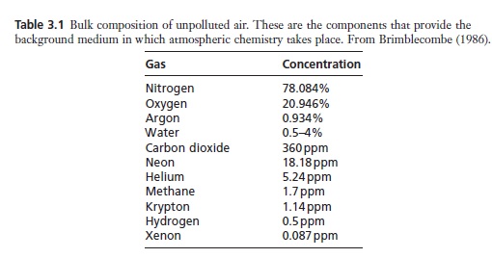
Bulky Concentration of Unpolluted Air

Slide 24
TEXT BOX
The total pressure of a mixture of gases is equal to the sum of the pressures of the individual components.
The pressure–volume relationship of an ideal gas (i.e. a gas composed of atoms with negligible volume and which undergo perfectly elastic collisions with one another) is defined as;
pV = nRT
where p is the partial pressure,
V the volume, n the number of moles of gas,
R the gas constant and T the absolute temperature

Slide 25
TEXT BOX
Real gases behave like ideal gases at low pressure and we denote a mixture of gases (1, 2, 3) through the use of subscripts:
p₁V = n₁ RT
p₂ V = n₂ RT
p₃ V = n₃ RT

Slide 26
TEXT BOX.
.
Hence:
(p₁ + p₂ + p₃ )V = (n₁ + n₂ + n₃ )RT
Or
p_{T}V = (n₁ + n₂ + n₃ )RT
where pT is the total pressure of the mixture.

Slide 27
TEXT BOX.
The implication that partial pressure p_{i} is a function of n_{i} means that the barometric law
p_{z} = p_{o} (-z
can be rewritten:
n_{z} = n_{o} (-z H)
or even:
c_{z} = c_{o}(-z H)

Slide 28
TEXT BOX
where c is some unit of the amount of material per unit volume (gm-3 or molecules cm-3).
The barometric law predicts that pressure and concentration of gases in the atmosphere decline at the same rate with height.
The relationship between partial pressure and gas-phase concentration explains why concentrations in the atmosphere are frequently expressed in parts per million (ppm) or parts per billion (ppb)
This is done on a volume basis so that 1ppm means 1 cm³ of a substance is present in 10⁶cm³ of air.
It also requires that there is one molecule of the substance present for every million molecules of air, or one mole of the substance present for every million moles of air.

Slide 29
TEXT BOX
This ppm unit is thus a kind of mole ratio. It can be directly related to pressure through the law of partial pressure, so at one atmosphere (1atm) pressure a gas present at a concentration of 1 ppm will have a pressure of 10⁻⁶atm.

Slide 30
Steady state or equilibrium?
Let us look at an individual trace gas in the atmosphere. We will take methane (CH₄), not an especially reactive gas, as an illustration.
It is present in the atmosphere at about 1.7 ppm (Box 3.1).
Methane could be imagined to react with O₂ in the following way:
CH₄(g) + 2O₂(g) →CO₂(g) + 2H₂O(g)

Slide 31
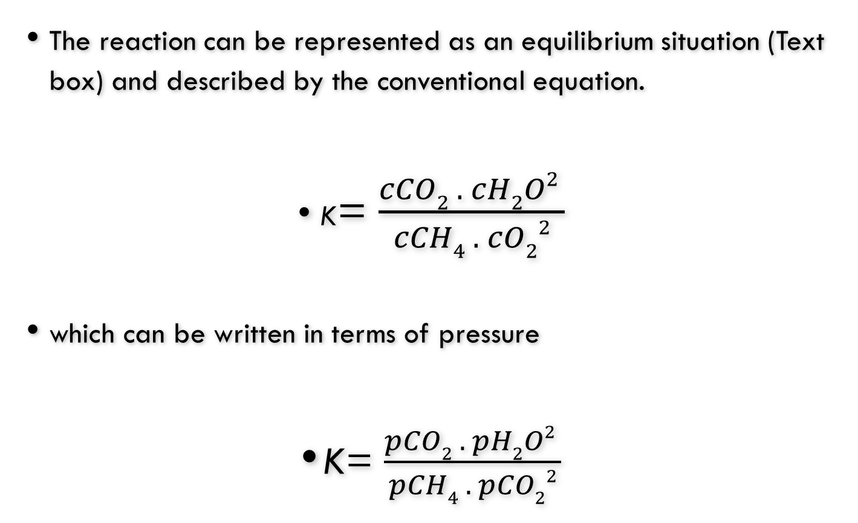
.
The reaction can be represented as an equilibrium situation (Text box) and described by the conventional equation.
K= $\frac{cCO2 . cH2O2 }{cCH4 . cO22}$
which can be written in terms of pressure
K= $\frac{pCO2 . pH2O2 }{pCH4 . pCO22}$

Slide 32
.
The equilibrium constant (K) is about 10¹⁴⁰ (Box ). This is an extremely large number, which suggests that the equilibrium position of this reaction lies very much to the right and that CH4 should tend to be at low concentrations in the atmosphere.
How low? We can calculate this by rearranging the equation and solving for CH4.
Oxygen, we can see from Table , has a concentration of about 21%, i.e. 0.21 atm, while CO2 and H2O have values of 0.000 36 and about 0.01 atm respectively.
Substituting these into equation and solving the equation gives an equilibrium concentration of 8 x 10⁻¹⁴⁷ atm.
This is very different from the value of 1.7 x 10⁻⁶ atm actually found present in air.

Slide 33
.
What has gone wrong? This simple calculation tells us that gases in the atmosphere are not necessarily in equilibrium.
This does not mean that atmospheric composition is especially unstable, but just that it is not governed by chemical equilibrium.
Many trace gases in the atmosphere are in steady state.
Steady state describes the delicate balance between the input and output of the gas to the atmosphere.
The notion of a balance between the source of a gas to the atmosphere and sinks for that gas is an extremely important one.
The situation is often written in terms of the equation:

Slide 34
.
F_{in} = F_{out} = A /ꚍ
where F_{in} and F_{out} are the fluxes in and out of the atmosphere, A is the total amount of the gas in the atmosphere and t is the residence time of the gas.
To be in steady state the input term must equal the output term.
Imagine the atmosphere as a leaky bucket into which a tap is pouring water. The bucket would fill for a while until the pressure rose and the leaks were rapid enough to match the inflow rate. At that point we could say that the system was in steady state.

Slide 35
.
Methane input into the atmosphere occurs at a rate of 500Tgyr-1 (i.e. 500 x 10⁹ kg yr-1).
We have seen that the atmosphere has CH₄ at a concentration of 1.7 ppm.
The total atmospheric mass is 5.2 x 10¹⁸ kg.
If we allow for the slight differences between the molecular mass of CH₄ and that of the atmosphere as a whole (i.e. 16/29), the total mass of CH₄ in the atmosphere can be estimated as 4.8 x 10¹² kg.
Substituting these values in equation 3.5 gives a residence time of 9.75 years.
This represents the average lifetime of a CH₄ molecule in the atmosphere (at least, it would if the atmosphere was very well mixed).
Residence time is the fundamental quantity that describes systems in steady state.
It is a very powerful concept that plays a central role in much of environmental chemistry.
Compounds with long residence times can accumulate to relatively high concentrations compared with those with shorter ones.
However, even though gases with short residence times are removed quickly, their high reactivity can yield reaction products that cause problems.

Slide 36
.
The famous atmospheric chemist C.E. Junge made an important observation about residence times and the variability of gases in the atmosphere.
If a gas has a long residence time, then it will have ample time to become well mixed in the atmosphere and thus would be expected to show great constancy in concentration all around the globe.
This is the case and the results of measurements are
illustrated in Fig. 3.3.

Slide 37
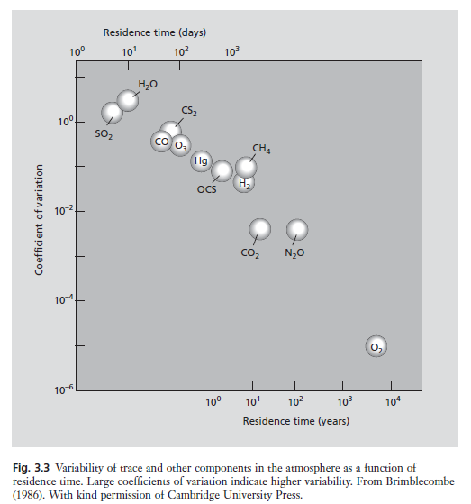
,

Slide 38
Natural sources
Since the atmosphere can be treated, on a large scale, as if it were in steady state we have a model that views the atmosphere as having sources, a reservoir (i.e. the atmosphere itself) and removal processes, all in delicate balance.
The sources need to be quite stable over the long term.
If they are not, then the balance will shift.
In terms of our earlier analogy, the level in the leaking bucket will change.
The best-known, and most worrying, example of such a shift is the increasing magnitude of the CO₂ source because of the consumption of vast amounts of fossil fuel by human activities.

Slide 39
.
This has given rise to a continuing increase in the CO₂ concentration in the atmosphere.
The predicted rise in temperature, due to the greenhouse effect, is explored in detail in Chapter 7.
There are many sources of trace components in the atmosphere, which can be divided into different categories, such as geochemical, biological and human or anthropogenic sources.
Some of these sources are hard to categorize. Is a forest fire a geochemical, biological or human source—particularly if the forest was planted or the fire started through human activities?
Although our definitions can become a little blurred, it is nevertheless useful to categorize sources.

Slide 40
1-Geochemical Sources
Perhaps the largest geochemical sources are wind-blown dusts and sea sprays, which put huge amounts of solid material into the atmosphere.
The dust is largely soil from arid regions of the Earth. If this dust is fine enough, it can spread over large areas of the globe and is important in redistributing material.
Often, however, the chemical effects of the dust in the atmosphere are not particularly evident, because dusts are not chemically very reactive.
By contrast, wind-blown sea spray places a more reactive entity into the atmosphere as salt particles.
The salt particles from the oceans are hygroscopic and under humid conditions these tiny NaCl crystals attract water and form a concentrated solution droplet or aerosol. Ultimately, this process can take part in cloud formation.
The droplets can also be a site for important chemical reactions in the atmosphere.
If strong acids in the atmosphere, perhaps nitric acid (HNO3) or sulphuric acid (H2SO4), dissolve in these small droplets, hydrogen chloride (HCl) can be formed.

Slide 41
.
It is thought that this process is an important source of HCl in the atmosphere:
H₂SO₄(in aerosol) +NaCl(in aerosol) → HCl(g) +NaHSO₄(in aerosol)
Incoming meteors also inject particles into the atmosphere. This is a very small source compared with wind-blown dust or forest fires, but meteors make their contribution to the upper parts of the atmosphere where the gas is at a low density.
Here, a small contribution can be particularly significant and the metals ablated from incoming meteors enter a series of chemical reactions.
Volcanoes are a large source of dust and particularly powerful eruptions can push dust into the stratosphere.
It has long been known that volcanic particles can change global temperature by blocking out sunlight. They can also perturb the chemistry at high altitudes.
Along with the dust, volcanoes are huge sources of gases such as sulphur dioxide (SO₂), CO₂, HCl and hydrogen fluoride (HF).
These gases can react in the stratosphere to provide a further source of particles, with H2SO4 being the most important particle produced indirectly from volcanoes.

Slide 42
.
It is important to realize that the volcanic source is a very discontinuous one, both in time and space. Large volcanic eruptions are infrequent.
It may be that years pass without any really major eruptions and then suddenly more material released in a single event than for many years previously.
The eruptions occur in very specific locations where there are active volcanoes.
In addition to massive eruptions that push great quantities of material into the upper parts of the atmosphere, we must not neglect smaller fumarolic emissions, from volcanic cracks and fissures, which gently release gases to the lower atmosphere over very long periods of time.
The balance between these two volcanic sources is not accurately known, although for SO₂ it is probably about 50 : 50.
Notes:
Fumarolic=Holes or cracks in a volcano discharging gases and vapours.

Slide 43
.
Radioactive elements in rocks (see Section 2.8), most importantly potassium (K) and heavy elements such as radium (Ra), uranium (U) and thorium (Th), can release gases.
Argon (Ar) arises from potassium decay and radon (Rn, a radioactive gas that has a half-life of 3.8 days) from radium decay. The uranium–thorium decay series results in the production of a particles, which are helium nuclei.
Once these nuclei capture electrons, helium has effectively been added to the atmosphere.
Helium has not accumulated in the atmosphere over time because it is light enough to escape into space.
The concentration of helium has been thus maintained in steady state through a balance of radioactive emanation from the crust and loss from the top of the atmosphere.

Slide 44
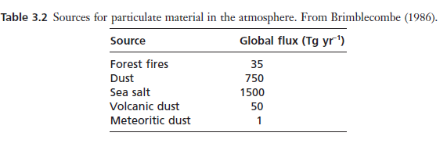
.

Slide 45
2-Biological sources of ATM
Unlike the geological sources, biology does not appear to be a large direct source of particles to the atmosphere, unless we consider forest fires to be a biological source.
Table 3.2 shows that forest fires are quite an important source of carbon (C), i.e. soot/smoke particles.
The living forest also plays an important role in exchanging gases with the
atmosphere. The major gases O2 and CO2 are, of course, involved in respiration and photosynthesis. However, forests also emit enormous quantities of trace organic compounds.
Terpenes, (a class of lipids) such as pinene and limonene give forests their wonderful odour.
Forests are also important sources of organic acids, aldehydes and other organic compounds.

Slide 46
.
Although forests are obvious as sources of gas, it is the microorganisms that are especially important in generating atmospheric trace gases.
Methane, which we have already discussed, is generated by reactions in anaerobic systems.
Damp soils, as found in marshes or rice paddles, are important microbiologically dominated environments, as are the digestive tracts of ruminants such as cattle.
The soils of the Earth are rich in nitrogen compounds, giving rise to a whole range of active nitrogen chemistry that generates many nitrogenous trace gases.
We can consider urea (NH2CONH2), present in animal urine, as a typical biologically generated nitrogen compound in soil. Hydrolysis converts NH2CONH2 to ammonia (NH3) and CO2 according to the equation:
NH2CONH2(aq) +H2O(l) → 2NH3(g) +CO2(g)

Slide 47
.
If the soil where this hydrolysis occurs is alkaline (Box 3.3), gaseous NH3 can be released, although in acidic conditions it will react to form the non-volatile ammonium ion (NH4 +):
NH₃(g) + H(aq) → NH₄ ⁺(aq)
Plants can absorb soil NH₃ or NH₄⁺ directly and some microorganisms, such as Nitrosomonas, oxidize NH₃, using it as an energy source for respiration, in the same way that other cells use reduced carbon compounds. One possible reaction would be:
2NH₃(g) + 2O₂(g) → N₂O(g) +3H₂O(g)
Here we can see a biological source for nitrous oxide (N₂O), an important and rather stable trace gas in the troposphere.

Slide 48
.
In nature there are many other reactions of nitrogen compounds in soils that produce the gases: NH₃, N₂, N₂O and nitric oxide (NO).
Microorganisms in the oceans also prove to be an enormous source of atmospheric trace gases.
Seawater is rich in dissolved sulphate and chloride (and to a lesser extent salts of the other halogens: fluorine (F), bromine (Br) and iodine (I)).
Marine microorganisms metabolize these elements, for reasons that are not properly understood, to generate sulphur (S) and halogen-containing trace gases.
However, the nitrate concentration of surface seawater is so low that the oceans are effectively a nitrogen desert.
This means that seawater is not such a large source of nitrogen-containing trace gases

Slide 49
,
Organosulphides produced by marine microorganisms make a particularly significant contribution to the atmospheric sulphur burden.
The most characteristic compound is dimethyl sulphide (DMS; (CH₃)₂S; Fig. 3.4a).
This volatile compound is produced by marine phytoplankton, such as Phaeocystis pouchetii, in the upper layers of the ocean by the hydrolysis of betadimethylsulphoniopropionate (DMSP; (CH₃)2S+CH₂CH₂COO-) to DMS and acrylic acid (CH2CHCOOH):
PP + (CH3)2S⁺CH2CH2COO –aq→ (CH3)2S (g) +CH2CHCOOH (aq)

Slide 50
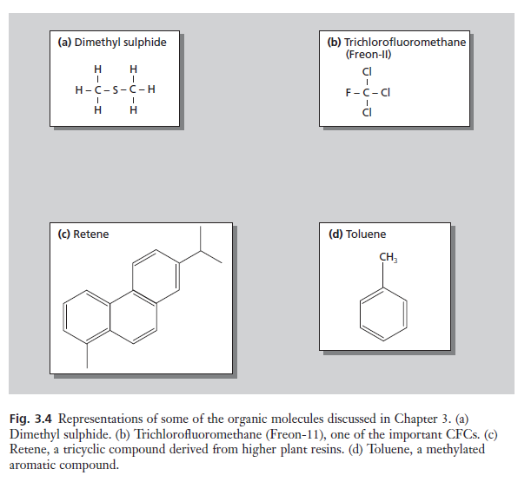
.

Slide 51
,
Another important sulphur compound released from the oceans is carbonyl sulphide (OCS). This can be produced by reaction between carbon disulphide (CS₂) and water:
CS₂(g) +H₂O(g) → OCS(g) + H₂S(g)
and, although the flux to the atmosphere is smaller than that of DMS, its stability means that it will accumulate to higher concentrations.
These sulphur gases have low solubility in water , making them able easily to escape from the oceans into the atmosphere.

Slide 52
. Halogenated organic compounds
Halogenated organic compounds are well known in the atmosphere.
Although these have an obvious human source, being present in cleaning fluids, fire extinguishers and aerosol propellants, they also have a wide range of biological sources.
Methyl chloride (CH₃Cl) is the most abundant halocarbon in the atmosphere and arises primarily from poorly understood marine sources, although terrestrial microbiological processes and biomass burning also contribute.
Bromine- and iodine-containing organic compounds are also released from the oceans and the distribution of this marine iodine over land-masses represents an important source of this essential trace element for mammals.
As one might predict, the iodine-deficiency disease, goitre, has been common in regions remote from the oceans.

Slide 53
Reactivity of trace substances in the atmosphere
Gases with short residence times in the atmosphere are clearly those that can be removed easily. Some of these gases are removed by being absorbed by plants or solids or into water.
However, chemical reactions are the usual reason for a gas having a short residence time.
What makes gases react in the atmosphere? It turns out that most of the trace gases listed in Table 3.3 are not very reactive with the major components of air.
In fact, the most important reactive entity in the atmosphere is a fragment of a water molecule, the hydroxyl (OH) radical.
This radical (a reactive molecular fragment) is formed by the photochemically initiated reaction sequence, started by the photon of light, hv:

Slide 54
.
O₃(g) + hv →O₂(g) +O(g)
O(g) +H₂O(g) →2OH(g)
The OH radical can react with many compounds in the atmosphere and thus it has a short residence time. The rates are faster than with abundant gases such as O₂.
The reaction between nitrogen dioxide (NO₂) and the OH radical leads to the formation of HNO₃, an important contributor to acid rain.
NO₂(g) +OH(g) → HNO₃(g)

Slide 55
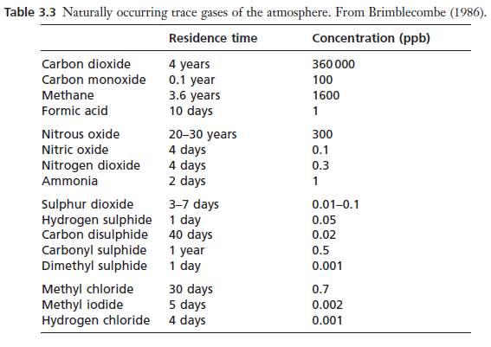
,

Slide 56
.
By contrast, kinetic measurements in the laboratory (which aim at determining the speed of reaction) show that gases that have slow rates of reaction with the OH radical have a long residence time in the atmosphere. Table 3.3 shows that OCS, N2O and even CH₄ have long residence times.
The CFCs (chlorofluorocarbons, Fig. 3.4b: refrigerants and aerosol propellants) also have very limited reactivity with OH. Gases like these build up in the atmosphere and eventually leak across the tropopause into the stratosphere.
Here a very different chemistry takes place, no longer dominated by OH but by reactions which involve atomic oxygen (i.e. O).
Gases that react with atomic oxygen in the stratosphere can interfere with the production of O₃:
O(g) +O2(g) → O3(g)

Slide 57
.
And can be responsible for the depletion of the stratospheric O₃ layer. This means that CFCs are prime candidates for causing damage to stratospheric O₃ .
We should note that nitrogen compounds are also damaging to O₃ if they can be transported to the stratosphere, because they are involved in similar reaction sequences.
We have already seen that tropospheric NO₂ is unlikely to be transferred into the stratosphere .
It was, however, nitrogen compounds from the exhausts of commercial supersonic aircraft flying at high altitude that were the earliest suggested contaminants of concern. In this case the gases did not have to be unreactive and slowly transfer to the stratosphere, but were directly injected from aircraft engines.

Slide 58
.
A large stratospheric transport fleet never came about, so attention has now turned to N₂O, a much more inert oxide of nitrogen produced at ground level and quite capable of getting into the stratosphere.
This gas is produced both from biological activities in fertile soils and by a range of combustion processes—most interestingly, automobile engines with catalytic converters.
Finally, we should note that some reactions lead to the formation of particles in the atmosphere. Most particles are effectively removed by rainfall and thus have residence times close to the 4–10 days of atmospheric water.
By contrast, very small particles in the 0.1–1mm size range are not very effectively removed by rain droplets and have rather longer residence times.

Slide 59
The urban atmosphere
In the section above we began to look at human influence on the atmosphere.
The changes wrought by humans are important, though often subtle on the
global scale. It is in the urban atmosphere where human influence shows its clearest
impact, so it is necessary to treat the chemistry of the urban atmosphere as a
special case.
In urban environments there are pollutant compounds emitted to the atmosphere
directly and these are called primary pollutants. Smoke is the archetypical
example of a primary pollutant. However, many compounds undergo reactions in the atmosphere, as we have seen in the section above.
The products of such reactions are called secondary pollutants. Thus, many primary pollutants can react to produce secondary pollutants. It is the distinction between primary and secondary pollution that now governs our understanding of the difference between two quite distinct types of air pollution that affect major cities of the world.

Slide 60
London smog—primary pollution
Urban pollution is largely the product of combustion processes. In ancient times cities such as Imperial Rome experienced pollution problems due to wood smoke.
However, it was the transition to fossil fuel burning that caused the rapid development of air pollution problems. The inhabitants of London have burnt coal since the 13th century.
Concern and attempts to regulate coal burning began almost immediately, as there was a perceptible and rather strange smell associated with it.
Medieval Londoners thought this smell might be associated with disease.
Fuels usually consist of hydrocarbons, except in particularly exotic applications such as rocketry, where nitrogen, aluminium (Al) and even beryllium (Be) are sometimes used.
:

Slide 61
.
Normal fuel combustion is an oxidation reaction and can be described
‘4CH’ _{(fuel)} +5O_{2(g)} → 4CO_{2(g)} (carbon dixide) + 2H₂O_{(g)}
This would not seem an especially dangerous activity as neither CO2 nor water is particularly toxic. However, let us consider a situation where there is not enough O2 during combustion, i.e. as might occur inside an engine or boiler. The equation might now be written:
‘4CH’ _{(fuel)} +3O_{2(g)} → 4CO_{(g)}(carbon monoxide) + 2H₂O_{(g)}
Here we have produced carbon monoxide (CO), a poisonous gas. With even less oxygen we can get carbon (i.e. smoke):
‘4CH’ _{(fuel)} +O_{2(g)} → 4C_{(s)} (smoke)+ 2H₂O_{(g)}

Slide 62
.
At low temperatures, in situations where there is relatively little O2, pyrolysis reactions (i.e. reactions where decomposition takes place as a result of heat) may cause a rearrangement of atoms that can lead to the formation of polycyclic aromatic hydrocarbons (PAH) during combustion. The most notorious of these is benzo[a]pyrene (B[a]P; see Fig. 2.4), a cancer-inducing compound.
Thus, although the combustion of fuels would initially seem a harmless activity, it can produce a range of pollutant carbon compounds.
When the earliest steam engines were being designed, engineers saw that an excess of oxygen would help convert all the carbon to CO₂. To overcome this they adopted a philosophy of ‘burning your own smoke’, even though this required considerable skill to implement and was consequently of only limited success.
In addition to these problems, contaminants within the fuel can also cause air pollution. The most common and worrisome impurity in fossil fuels is sulphur (S), partly present as the mineral pyrite, FeS₂.
There may be as much as 6% sulphur in some coals and this is converted to SO₂ on combustion: 4FeS₂(s) +11O₂(g) → 8SO₂(g) + 2Fe₂O₃(s)

Slide 63
.
There are other impurities in fuels too, but sulphur has always been seen as most characteristic of the air pollution problems of cities.
If we look at the composition of various fuels (Table 3.4), we see that they contain quite variable amounts of sulphur.
The highest amounts of sulphur are found in coals and in fuel oils. These are the fuels used in stationary sources such as boilers, furnaces (and traditionally steam engines), domestic chimneys, steam turbines and power stations.
Thus, the main source of sulphur pollution, and indeed smoke, in the urban atmosphere is the stationary source. Smoke too is mainly associated with stationary sources. Steam trains and boats caused the occasional problem, but it was the stationary source that was most significant.
For many people, SO2 and smoke came to epitomize the traditional air pollution problems of cities. Smoke and SO2 are obviously primary pollutants because they are formed directly at a clearly evident pollutant source and enter the atmosphere in that form.

Slide 64
.
Classical air pollution incidents in London occurred under damp and foggy conditions in the winter. Fuel use was at its highest and the air near-stagnant.
The presence of smoke and fog together led to the invention of the word smog (sm[oke and f]og), now often used to describe air pollution in general (Fig. 3.5).
Sulphur dioxide is fairly soluble so could dissolve into the water that condensed around smoke particles.
SO_{2(g)} H₂O_{( l)} → H⁺_{(aq)} HSO₃⁻ aq
Traces of metal contaminants (iron (Fe) or manganese (Mn)) catalysed the conversion of dissolved SO₂ to H₂SO₄ (see Box 4.4 for a definition of catalyst)
2 HSO₃⁻ (aq) O₂ (aq)→ 2H⁺ (aq) +2SO₄²⁻(aq)

Slide 65
.
Sulphuric acid has a great affinity for water so the droplet absorbed more water. Gradually the droplets grew and the fog thickened, attaining very low pH values
(see Box 3.5).
Terrible fogs plagued London at the turn of the last century when Sherlock Holmes and Jack the Ripper paced the streets of the metropolis.
The incidence of bronchial disease invariably rose at times of prolonged winter fog—little wonder, considering that the fog droplets contained H₂SO₄.
Medical registrars in Victorian England realized that the fogs were affecting health, but they, along with others, were not able to legislate smoke out of existence.
Even where there was a will, and indeed there were enthusiasts in both Europe and North America who strove for change, the technology was far too naïve to achieve really noticeable improvements.
The improvements that did come about were often due to changes in fuel, in location of industry or in climate.

Slide 66
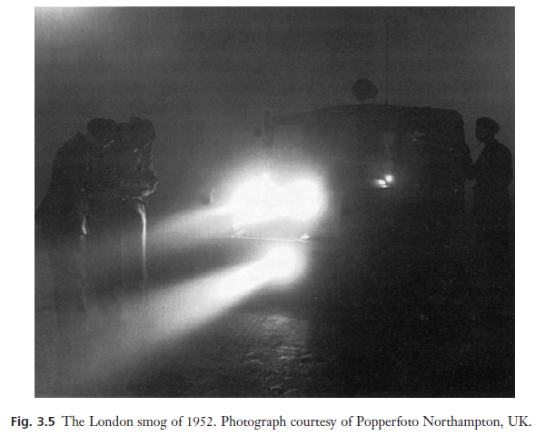
LONDON FOG, 1952

Slide 67
Los Angeles smog—secondary pollution
The air pollutants that we have been discussing so far have come from stationary sources. Traditionally, industrial and domestic activities in large cities burnt coal. The transition to petroleum-derived fuels this century has seen the emergence of an entirely new kind of air pollution.
This newer form of pollution is the result of the greater volatility of liquid fuels. The motor vehicle is such an important consumer of liquid fuels that it has become a major source of contemporary air pollution. However, the pollutants really responsible for causing the problems are not themselves emitted by motor vehicles.
Rather, they form in the atmosphere. These secondary pollutants are formed from the reactions of primary pollutants, such as NO and unburnt fuel, which come directly from the automobiles.
Chemical reactions that produce the secondary pollutants proceed most effectively in sunlight, so the resulting air pollution is called photochemical smog.

Slide 68
.TEXT BOX ph SCALE
The acidity of aqueous solutions is frequently described in terms of the pH scale. Acids (Box 3.3) give rise to hydrogen ions (H+) in solution and the pH value of such a solution is defined:
pH =-log₁₀ H⁺(aq)
We can write a similar relationship
identifying pOH:
pOH = - log₁₀( OH⁻(aq) )
However, pH is related to pOH through the equilibrium describing the dissociation of water:
H₂O <=> H⁺ + OH⁻ ie w H OH ª ,
Kw = 1 x 10⁻¹⁴ = a H⁺. a OH⁻
such that pH = 14—pOH.

Slide 69
TEXT BOX ph SCALE
It is important to notice that this is a logarithmic scale, so it is not appropriate to average pH values of solutions (although one can average H+ concentrations).
On the pH scale, 7 is regarded as neutral. This is the point where aH+ = aOH-. There are a number of other important values on the scale (conventionally made to stretch from 0 to 14) that are relevant to the environment.
pH scale showing values for familiar commodities (above the scale) and various environmental fluids discussed in this book (below the scale).
Soil pH is measured on pure water (pH 7) equilibrated with the soil solids.
Note that naturally alkaline fluids are rare. Industrial processing that involves strong bases like NaOH (e.g. bauxite processing) or Ca(OH)₂ (lime production) can contaminate river waters to around pH 10.

Slide 70
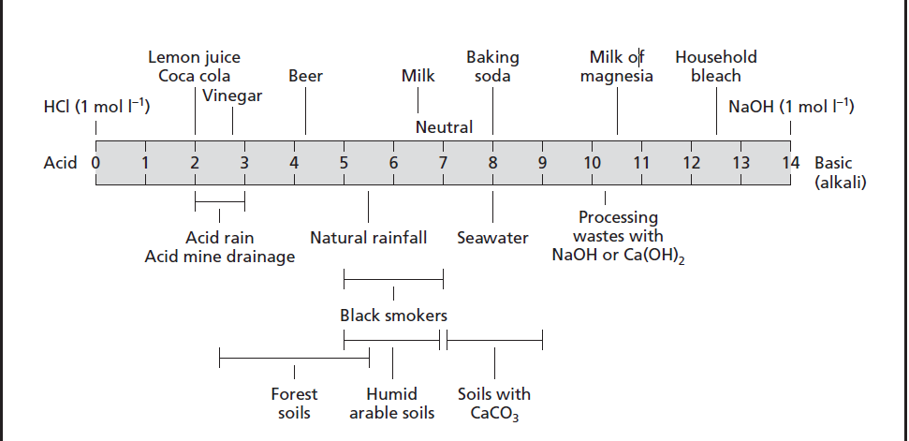
pH Values of some common solvents

Slide 71
.
Photochemical smog was first noticed in Los Angeles during the Second World War. Initially it was assumed to be similar to the air pollution that had been experienced elsewhere, but conventional smoke abatement techniques failed to lead to any improvement.
In the 1950s it became clear that this pollution was different, and the experts were baffled.
A. Haagen-Smit, a biochemist studying vegetation damage in the Los Angeles basin, realized that the smog was caused by reactions of automobile exhaust vapours in sunlight.
Although air pollution and smoke have traditionally been closely linked, there were always those who thought there was more to air pollution than just smoke.
We can now see how impurities in fuel give rise to further pollutants. In addition, the fact that we burn fuels, not in O₂, but in air has important consequences.

Slide 72
.
We have learnt that air is a mixture of O₂ and N₂. At high temperature, in a flame, molecules in air may fragment, and even the relatively inert N2 molecule can undergo reaction:
O(g) +N₂(g) → NO(g) +N(g)
N(g) +O₂(g) → NO(g) +O(g)
Equation produces an oxygen atom, which can re-enter equation . Once an oxygen atom is formed in a flame, it will be regenerated and contribute to a whole chain of reactions that produce NO.
If we add these two reactions we get:
N₂(g) +O₂(g) → 2NO(g)
The equations show how nitrogen oxides are generated in flames.
They arise because we burn fuels in air rather than just in O₂. In addition, some fuels contain nitrogen compounds as impurities, so the combustion products of these impurities are a further source of nitrogen oxides (i.e. NOx, the sum of NO and NO₂).

Slide 73
.
2NO(g)) + O₂→ 2NO₂(g)
Oxidation of nitric oxide in smog gives nitrogen dioxide (Box 3.6), which is a brown gas. This colour means that it absorbs light and is photochemically active and undergoes dissociation:
NO₂(g) + hv→ O(g) +NO(g)
The above Equation thus reforms the nitric oxide, but also gives an isolated and reactive oxygen atom, which can react to form O₃:
O(g) +O₂(g) → O₃(g)
Ozone is the single pollutant that most clearly characterizes photochemical smog.
However, O₃, which we regard as such a problem, is not emitted by automobiles (or any major polluter). It is a secondary pollutant.
The volatile organic compounds released through the use of petroleum fuels serve to aid the conversion of NO to NO₂.

Slide 74
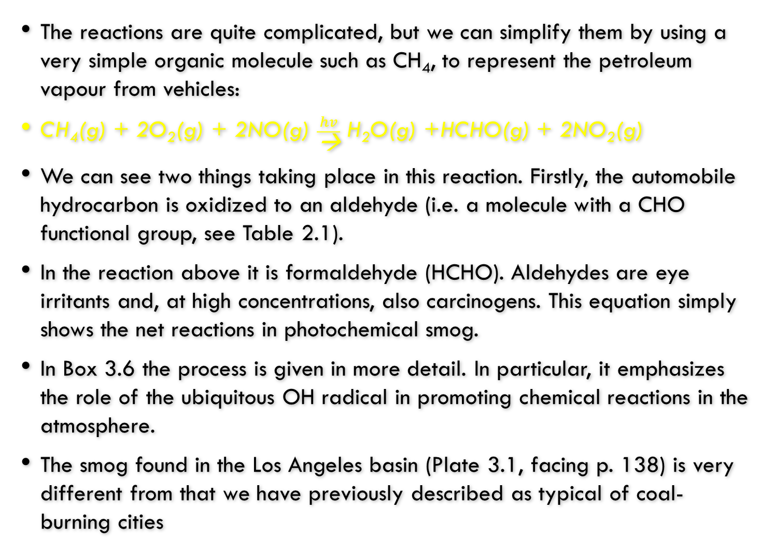
.
The reactions are quite complicated, but we can simplify them by using a very simple organic molecule such as CH₄, to represent the petroleum vapour from vehicles:
CH₄(g) + 2O₂(g) + 2NO(g) $\frac{hv}{\text{→}}$ H₂O(g) +HCHO(g) + 2NO₂(g)
We can see two things taking place in this reaction. Firstly, the automobile hydrocarbon is oxidized to an aldehyde (i.e. a molecule with a CHO functional group, see Table 2.1).
In the reaction above it is formaldehyde (HCHO). Aldehydes are eye irritants and, at high concentrations, also carcinogens. This equation simply shows the net reactions in photochemical smog.
In Box 3.6 the process is given in more detail. In particular, it emphasizes the role of the ubiquitous OH radical in promoting chemical reactions in the atmosphere.
The smog found in the Los Angeles basin (Plate 3.1, facing p. 138) is very different from that we have previously described as typical of coal-burning cities

Slide 75
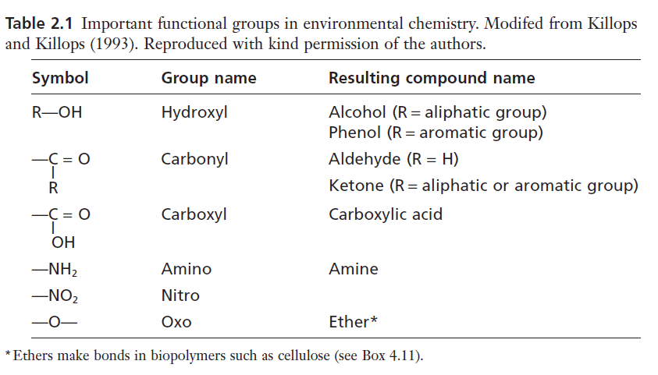
Table 2.1

Slide 76
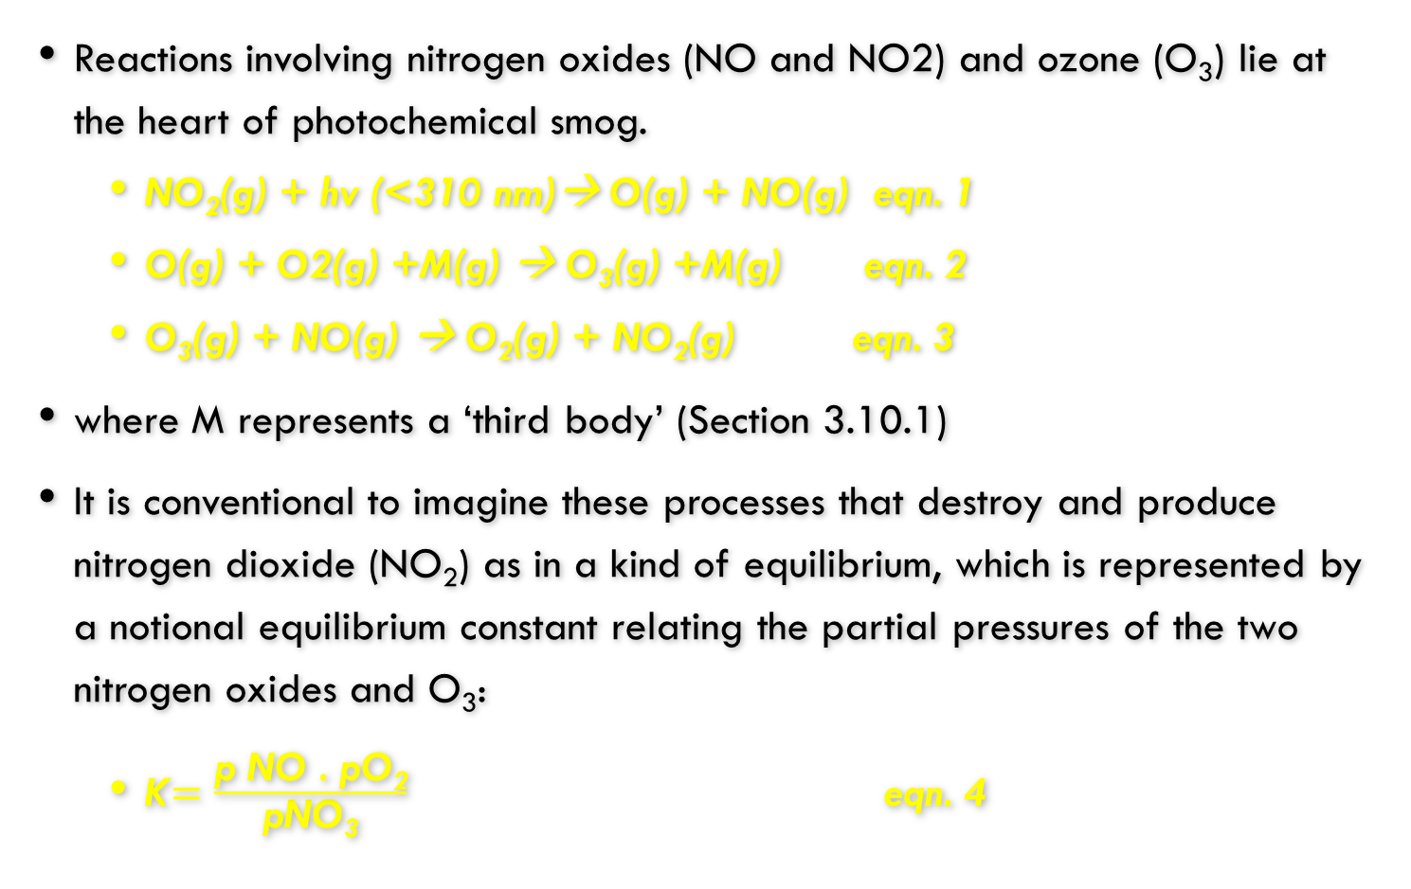
TEXT BOX
Reactions involving nitrogen oxides (NO and NO2) and ozone (O₃) lie at the heart of photochemical smog.
NO₂(g) + hv (<310 nm)→ O(g) + NO(g) eqn. 1
O(g) + O2(g) +M(g) → O₃(g) +M(g) eqn. 2
O₃(g) + NO(g) → O₂(g) + NO₂(g) eqn. 3
where M represents a ‘third body’ (Section 3.10.1)
It is conventional to imagine these processes that destroy and produce nitrogen dioxide (NO₂) as in a kind of equilibrium, which is represented by a notional equilibrium constant relating the partial pressures of the two nitrogen oxides and O₃:
K$=\frac{\text{p} \text{NO}\text{ . }\text{pO}\text{2}}{\text{pNO}\text{3}}$ eqn. 4

Slide 77
TEXT BOX
If we were to increase NO₂ concentrations (in a way that did not use O₃), then the equilibrium could be maintained by increasing O₃ concentrations.
This happens in the photochemical smog through the mediation of hydroxyl (OH) radicals in the oxidation of hydrocarbons. Here we will use methane (CH₄) as a simple example of the process:
OH(g) + CH₄(g) → H₂O(g) + CH₃(g) eqn. 5
CH₃(g) + O₂(g) → CH₃O₂(g) eqn. 6
CH3O2(g) + NO(g) → CH3O(g) + NO2(g) eqn. 7
CH3O(g) + O2(g) → HCHO(g) +HO2(g) eqn. 8
HO2(g) + NO(g) → NO2(g) + OH(g) eqn. 9

Slide 78
.
These reactions represent the conversion of nitric oxide (NO) to NO₂ and a simple alkane (see Section 2.7) such as CH4 to an aldehyde (see Table 2.1), here formaldehyde (HCHO).
Note that the OH radical is regenerated, so can be thought of as a kind of catalyst.
Although the reaction will happen in photochemical smog, the attack of the OH radical is much faster on larger and more complex organic molecules. Aldehydes such as acetaldehyde (CH3CHO) may also undergo attack by OH radicals:
CH₃CHO(g) + OH(g) → CH₃CO(g) +H2O(g) eqn. 10
CH3CO(g) + O2(g) → CH3COO2(g) eqn. 11
CH3COO2(g) + NO(g) → NO2(g) + CH3CO2(g) eqn. 12
CH3CO2(g) → CH3(g) + CO2(g) eqn. 13

Slide 79
TEXT BOX
The methyl radical (CH3) in equation 13 may re-enter at equation 6. An important branch to this set of reactions is:
CH₃ COO_{2(g)} + NO_{2(g)} → CH₂ COO₂NO_{2(g)} (PAN) eqn. 14
leading to the formation of the eye irritant peroxyacetylnitrate (PAN).

Slide 80
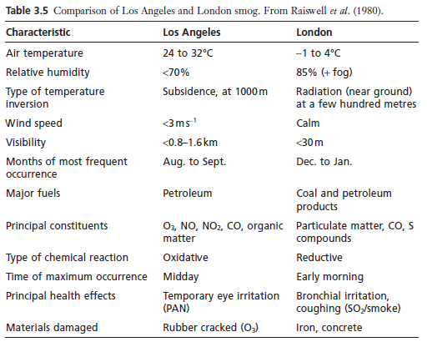
.

Slide 81
21st-century particulate pollution
It is valid to ask what might be different about pollution in the early 21st century One of the most notable issues in the last decade or so has been a rise in concern about fine particles (or aerosols) in the atmosphere. Some of this concern has come about because fine particles are now more noticeable because we have lessened the emission of many pollutant gases and smoke into the atmosphere. In some cases the concentrations of these particles have increased in urban air.
There has also been a growing awareness that fine particles have a significant impact on health. Fine particles are those that are respirable. Traditionally this would have been particles less than 10mm in diameter that can make their way into the respiratory system. These particles, often referred to as PM-10 (PM is short for particulate matter), are usually accompanied by even finer particles about 2.5mm called PM- 2.5.
These finer particles can go deep into the lung and become deposited in the alveoli, the terminal sacs of the airways, where gases are exchanged with the blood. Once in the alveoli various biochemical processes seek to combat the invading particles which ultimately place the individual under increased stress and at risk from a range of health effects.

Slide 82
.
These fine particles come from a range of sources including some that come from combustion processes. In the late 20th century the increasing importance of the diesel engine in vehicles added to the fine particle concentrations of European cities.
The diesel engine can emit very small particles, perhaps only 0.1mm across, but these readily coagulate into somewhat larger particles. These particles can also become coated with a range of organic compounds, which have the potential to be carcinogenic contributing to long-term health impacts.
Reactions in the atmosphere lead to the formation of secondary particles. The best known of these are sulphate particles from the oxidation of SO₂ (eqns. 3.20 & 3.21).
These particles are usually acid, although partial neutralization to ammonium bisulphate (NH₄HSO₄) is also possible. These particles have the potential to have additional irritant effects on the respiratory system. In recent years there has been a rising interest in the organic fraction of secondary aerosols with an awareness of the complexity of its chemistry. When volatile organic substances (see Box 4.14) react in the atmosphere they are typically converted to aldehydes, ketones (see Table 2.1) and organic acids.
These more oxidized organic compounds are usually less volatile and can become associated with particles.

Slide 83
.
Particles in the atmosphere, which range in size from about one-half millimetre (the size of sand or drizzle) down to molecular dimensions, are made up of an amazing variety of materials and discrete objects that may consist of either solids or liquid droplets (Table 15.1).
Particulates is a term that has come to stand for particles in the atmosphere, although particulate matter or simply particles, is preferred usage.
Particulate matter makes up the most visible and obvious form of air pollution.
Atmospheric aerosols are solid or liquid particles smaller than 100 μm in diameter.
Pollutant particles in the 0.001 to 10 μm range are commonly suspended in the air near sources of pollution, such as the urban atmosphere, industrial plants, highways, and power plants

Slide 84
Important Terms Describing Atmospheric Particles
Term | Meaning
Aerosol | Colloidal-sized atmospheric particle
Condensation aerosols | Formed by condensation of vapours or reactions of gases
Dispersion aerosol | Formed by grinding of solids, atomization of liquids
Fog | Term denoting high level of water droplets
Haze | Denotes decreased visibility due to the presence of particles
Mists | Liquid particles
Smoke | Particles formed by incomplete combustion of fuel

Slide 85
.
Very small, solid particles include carbon black, silver iodide, combustion nuclei, and sea-salt nuclei formed by the loss of water from droplets of seawater.
Larger particles include cement dust, wind-blown soil dust, foundry dust, and pulverized coal.
Liquid particulate matter, mist, includes raindrops, fog, and sulfuric acid droplets.
Some particles are of biological origin, such as viruses, bacteria, bacterial spores, fungal spores, and pollen.
Particulate matter may be organic or inorganic; both types are very important atmospheric contaminants.

Slide 86
Chemical Processes for Inorganic Particle Formation
Metal oxides constitute a major class of inorganic particles in the atmosphere.
These are formed whenever fuels containing metals are burned.
For example, particulate iron oxide is formed during the combustion of pyrite-containing coal:
3FeS2 + 8O2 → Fe3O4 + 6SO2
Organic vanadium in residual fuel oil is converted to particulate vanadium oxide. Part of the calcium carbonate in the ash fraction of coal is converted to calcium oxide and is emitted to the atmosphere through the stack:
CaCO3 + heat ® CaO + CO2

Slide 87
.
common process for the formation of aerosol mists involves the oxidation of atmospheric sulfur dioxide to sulfuric acid, a hygroscopic substance that accumulates atmospheric water to form small liquid droplets:
2SO₂ + O₂ + 2H₂O → 2H₂SO₄
When basic air pollutants, such as ammonia or calcium oxide, are present, they react with sulfuric acid to form salts:
H₂SO₄(droplet) + 2NH₃(g) → (NH₄)₂SO₄ (droplet)
H₂SO₄(droplet) + CaO(s) → CaSO₄( droplet)
Under low-humidity conditions, water is lost from these droplets and a solid salt aerosol is formed.
The preceding examples show several ways in which solid or liquid inorganic aerosols are formed by chemical reactions.
Such reactions constitute an important general process for the formation of aerosols, particularly the smaller particles.

Slide 88
.
Oxalic acid, a dicarboxylic acid (HOOC.COOH), is a highly oxidized small organic compound and is typical of the oxidation products found in the modern urban atmosphere. It is a relatively strong acid and not at all volatile, so readily incorporated into fine particles.
This acid is also able to form complexes (see Box 6.4) with metals such as iron in the aerosol particles. Concern about the health impacts of small primary and secondary particles has driven much research into aerosols in urban air.
The 1990s was also a period when there was an increased awareness of the transport of pollutants from large-scale forest fires into areas with large populations.
This was most notably reported in terms of smoke from tropical fires in South East Asia, although there were also worries about carbon monoxide from fires spreading into cities of the USA. In China, Korea and Japan there have been observations of increased haze in the air as particulates drift eastward from central China

Slide 89
.
Some of the particulate material is from wind-blown dust, but this is mixed with agricultural and industrial pollutants and even the soot from cooking stoves.
Although there has been much discussion of the health effects of the smoke from such sources, studies have typically had to rely on information about urban aerosols, which are likely to be rather different.
Biomass burning yields many millions of tonnes of soot, which has a graphitic structure and characteristic organic compounds such as abietic acid and retene (Fig. 3.4c) derived from plant resins.
Potassium and zinc are also likely to be found in the particles from forest fires.

Slide 90
Air pollution and health
We saw in Section 3.6.1 that the acid-laden smoke particles in the London atmosphere caused great harm to human health in the past.
Pollutants in the atmosphere still cause concern because of their effect on human health, although today we need to consider a wider range of potentially harmful trace substances.
The photochemical smog encountered ever more widely in modern cities gives urban atmospheres that are unlike the smoky air of cities in the past.
Petrol as a fuel, unlike coal, produces little smoke.

Slide 91
.
The two gases that particularly characterize photochemical smog, O₃ and nitrogen oxides, caused particular concern because of their potential to induce respiratory problems. Ozone impairs lung function, while nitrogen oxides at high concentrations are particularly likely to affect asthmatics.
Oxygen-containing compounds, such as aldehydes, cause eye, nose and throat irritation, as well as headaches, during periods of smog.
Eye irritation is a frequent complaint in Los Angeles and other photochemically polluted cities. This eye irritation is particularly associated with a group of nitrogen-containing organic compounds.
They are produced in reactions of nitrogen oxides with various organic compounds in the smog (Box 3.6).
The best known of these nitrogen-containing eye irritants is peroxyacetylnitrate, often called PAN.

Slide 92
.
Photochemical smog is not the only pollution problem created by vehicles.
Automobiles are also associated with other pollutants such as lead (Pb) and benzene (C₆H₆).
The success of lead tetralkyl compounds as antiknock agents for improving the performance of automotive engines has meant that, in countries with high car use, very large quantities of lead have been mobilized.
This lead has been widely dispersed, but particularly large quantities have been deposited in cities and near heavily used roads.
Lead is a toxin and has been linked with several environmental health problems. Perhaps the most worrying evidence has come from studies (although difficult to reproduce) which suggest a decline in intelligence among children exposed to quite low concentrations of lead.

Slide 93
.
Unleaded petrol was introduced in the USA in the 1970s so that catalytic converters could be used on cars. Since then, unleaded petrol has become used more widely. There is evidence that blood lead concentrations have dropped in parallel with the declining automotive source of lead.
Nevertheless, the decrease in atmospheric lead may not yet be enough to reduce possible subtle health effects in children to a satisfactory level.
This is because children have a high intake of food relative to their body weight.
Thus children are more likely than adults to consume a significant amount of their intake of lead with food and water.
Although some of the lead in foodstuffs may have come from the atmosphere, lead in foods may also result from processing.

Slide 94
BENZENE, C6H6
Benzene (see Fig. 2.4) is another pollutant component of automotive fuels. It occurs naturally in crude oil and is a useful component because it can prevent pre-ignition in unleaded petrol (the production process is usually adjusted so that the benzene concentration is about 5%).
There is evidence that in some locations, where there has been a switch to fuels with high concentrations of aromatic hydrocarbons, there has been a sharp increase in photochemical smog.
This is due to the high reactivity of these hydrocarbons in the urban atmosphere. This problem should draw our attention to the way in which the solution of one obvious environmental problem (lead from petrol) may introduce a second rather more subtle problem (i.e. increased photochemical smog from reactive aromatic compounds).
Benzene is also a potent carcinogen. It appears that more than 10% of the benzene used by society (33M tonne yr-1) is ultimately lost to the atmosphere.
High concentrations of benzene can be found in the air of cities and these concentrations may increase the number of cancers. Exposure is complicated by the importance of other sources of benzene to humans, for example tobacco smoke.

Slide 95
Toluene (C6H5CH3; Fig. 3.4d)
Toluene (C6H5CH3; Fig. 3.4d) is another aromatic compound present in large concentrations in petrol.
Toluene is less likely to be a carcinogen than benzene but it has some undesirable effects.
Perhaps most importantly it reacts to form a PAN-type compound, peroxybenzoyl nitrate, which is a potent eye irritant.

Slide 96
Particulate matter (PM-2.5)
The fine PM-2.5 is able to penetrate through the respiratory system all the way to the alveoli. Normally particles are removed from the respiratory system in the mucus which is driven upwards by fine hairs or cilia.
There are no cilia in the air sacs, so roving amoeba-like cells (macrophages) engulf the particles.
They can migrate upwards to the ciliated parts of the respiratory system or through the alveolar walls. The activities of the macrophages, although important, release inflammatory compounds.
The inflammatory effects can easily be transmitted to the blood, such that pulmonary inflammation can readily become associated with cardiovascular problems.
This explains the enhanced death rate often observed when human populations are exposed to particle-laden air

Slide 97
polycyclic aromatic hydrocarbons (PAH_{s}),
. In addition to these immediate effects the particles are rich in polycyclic aromatic hydrocarbons (PAHs), which are carcinogens and could explain some of the cancer incidence seen in urban populations.

Slide 98
Effects of air pollution In the past, when smoke was the predominant air pollutant, its effects were easy to see. Even today, black incrustations on older buildings in many large cities are still evident. In addition, clothes were soiled, curtains and hangings were blackened and plant growth was affected. City gardeners carefully chose only the most resistant plants. Early last century, the trees around industrial centres became soblackened that light-coloured moths were no longer camouflaged. Melanic (dark)forms became more common because predators could see them less easily. Plants are also very sensitive to SO2 and one of the first effects seems to be the inhibition of photosynthesis.

Slide 99
.
The traditional smog generated by coal burning contained SO₂ and its oxidation product, H₂SO₄, in addition to smoke. Sulphuric acid is a powerful corrosive agent and rusts iron bars and weathers building stones. Architects sometimes complained of layers of sulphate damage 10 cm thick on calcareous stone through the reaction:
H2SO4(aq) +CaCO3(s) +H2O(l) → CO2(g) +CaSO4(s).2H2O(l)
Sulphuric acid converts limestone (CaCO₃) into gypsum (CaSO₄ .2H₂O).
The deterioration is severe because gypsum is soluble and dissolves in rain. Perhaps more importantly, gypsum occupies a larger volume than limestone, which adds mechanical stress so that the stone almost explodes from within.
The diesel engine is no longer confined to large vehicles in Europe, as passenger cars have taken advantage of potentially lower fuel costs.
The fuel injection process of the diesel engine leads to the fuel dispersing as droplets within the engine.

Slide 100
.
These may not always burn completely, so diesel engines can produce large quantities of smoke if not properly maintained. Diesel smoke now makes a significant contribution to the soiling quality of urban air.
In the modern urban atmosphere, O₃ may be the pollutant of particular concern for health. However, it is a reactive gas that will also attack the double bonds of organic molecules (see Section 2.7) very readily.
Rubber is a polymeric material with many double bonds, so it is degraded and cracked by O₃.
Tyres and windscreen wiper blades are especially vulnerable to oxidants, although newer synthetic rubbers have double bonds protected by other chemical groups, which can make them more resistant to damage by O₃.

Slide 101
O3 and NOx
Many pigments and dyes are also attacked by O₃. The usual result of this is that the dye fades. This means that it is important for art galleries in polluted cities to filter their air, especially where they house collections of paintings using traditional colouring materials, which are especially sensitive.
Nitrogen oxides, associated with photochemical smogs, can also damage pigments.
It is possible that nitrogen oxides may also increase the rate of damage to building stone, but it is not really clear how this takes place. Some have argued that NO₂ increases the efficiency of production of H₂SO₄ on stone surfaces in those cities that have moderate SO₂ concentrations.
SO₂(g) +NO₂(g) +H₂O(l) → NO(g) +H₂SO₄(aq)

Slide 102
.
Others have suggested that the nitrogen compounds in polluted atmospheres enable microorganisms to grow more effectively on stone surfaces and enhance the biologically mediated damage.
There is also the possibility that gas-phase reactions produce HNO₃ (eqn. 3.14) and that this deposits directly on to calcareous stone.
Diesel soot that increasingly disfigures buildings may also carry
organic nutrients to the surface that could enhance biological damage.

Slide 103
.
Finally, not just materials that are damaged by photochemical smog, since plants are especially sensitive to the modern atmospheric pollutants.
Recollect that it was this sensitivity that led Haagen-Smit to recognize the novelty of the Los Angeles smog. Ozone damages plants by changing the ‘leakiness’ of cells to important ions such as potassium. Early symptoms
of such injury appear as water-soaked areas on the leaves.
Urban air pollution remains an issue of much public concern. While it is true
that in many cities the traditional problems of smoke and SO2 from stationary
sources are a thing of the past, new problems have emerged. In particular, the
automobile and heavy use of volatile fuels have made photochemical smog a widespread
occurrence. This has meant that there has been a parallel rise in legislation
to lower the emission of these organic compounds to the atmosphere.

Slide 104
Removal processes
So far, we have examined the sources of trace gases and pollutants in the atmosphere and the way in which they are chemically transformed. Now we need to look at the removal process to complete the source–reservoir–sink model of trace gases that we have adopted.
Our discussions have emphasized the importance of the OH radical as a key entity in initiating reactions in the atmosphere.
Attack often occurs through hydrogen abstraction, and subsequent reactions with oxygen and nitrogen oxides (as illustrated in Box 3.6). This serves to remind us that the basic transformation that takes place in the atmosphere is oxidation (see also Box 4.3). This is hardly unexpected in an atmosphere dominated by oxygen, so we can argue that reactions within the atmosphere generally oxidize trace gases.

Slide 105
.
Oxidation of non-metallic elements yields acidic compounds, and it is this that explains the great ease with which acidification occurs in the atmosphere.
Carbon compounds can be oxidized to organic compounds, such as formic acid (HCOOH) or acetic acid (CH₃COOH) or, more completely, to carbonic acid (H₂CO₃, i.e. dissolved CO₂). Sulphur compounds can form H₂SO₄ and, in the case of some organosulphur compounds, methane sulphonic acid (CH₃SO₃H).
Nitrogen compounds can ultimately be oxidized to HNO3. The solubility of many of these compounds in water makes rainfall an effective mechanism for their removal from the atmosphere.
The process is known as ‘wet removal’. It is important to note that, even in the absence of SO₂, atmospheric droplets will be acidic through the dissolution of CO₂ (Box 3.7).
This has implications for the geochemistry of weathering (see Section 4.4). The SO₂, however, does make a substantial contribution to the acidity of droplets in the atmosphere.

Slide 106
.
It can, so to speak, acidify rain (Box 3.7). However, let us consider the possibility of subsequent reactions that can cause even more severe acidification:
H₂O₂ (aq) + HSO3-(aq)→ SO₄²⁻ + H⁺ + H2O(l)
Hydrogen peroxide (H2O2) and O3 are the natural strong oxidants present in rainwater.
These oxidants can potentially oxidize nearly all the SO2 in a parcel of air.
Box 3.8 shows that under such conditions rainfall may well have pH values lower than 3.
This illustrates the high acid concentrations possible in the atmosphere as trace pollutants are transferred from the gas phase to droplets.
Liquid water in the atmosphere has a volume about a million times smaller than the gas phase; thus a substantial increase in concentration results from dissolution. O₃(aq)+HSO_{3(aq)} → SO₄²⁻(aq) + H⁺ (aq) +O₂ (aq)

Slide 107
.
After the water falls to the Earth, further concentration enhancement can take place if it freezes as snow. When snow melts the dissolved ions are lost preferentially, as they tend to accumulate on the outside of ice grains which make up snowpacks. This means that at the earliest stages of melting it is the dissolved H₂SO₄ that comes out.
Concentration factors of as much as 20-fold are possible.
This has serious consequences for aquatic organisms, and especially their young, in the spring as the first snows thaw. It is not just acid rain, but acid rain amplified.
It is also possible for gaseous or particulate pollutants to be removed directly from the atmosphere to the surface of the Earth under a process known as dry deposition.
This removal process may take place over land or the sea, but it is still termed ‘dry deposition’. It is really a bit of a misnomer because the surfaces available for dry deposition are often most effective when wet.

Slide 108
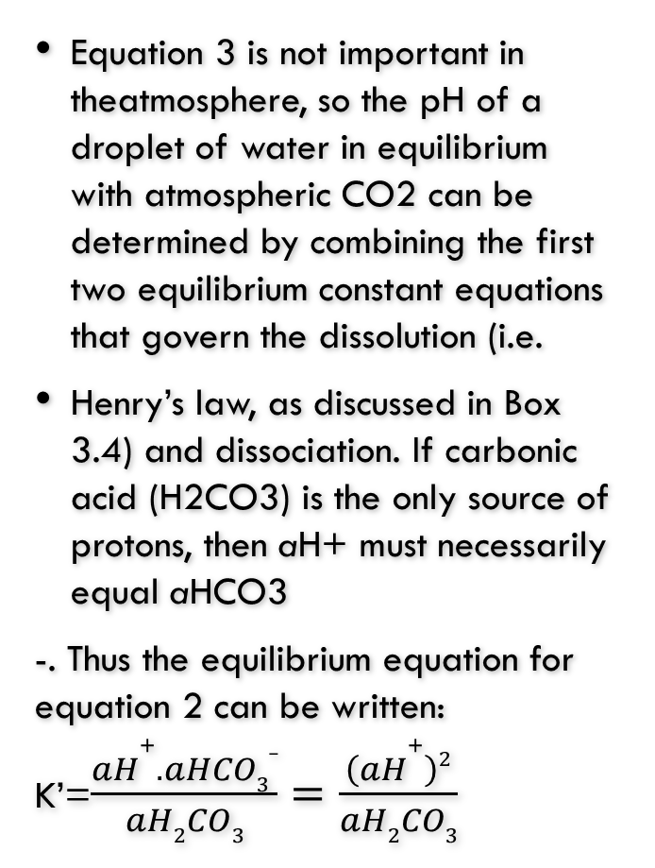
TEXT BOX-ACIDIFICATION OF RAIN DROPLETS
In Box 3.4 we saw the way reactions affect the solubility of gases. It is possible for some gases to undergo more complex hydration reactions in water, which influence its pH (see
Box 3.5). The best known of these is the dissolution of carbon dioxide (CO2), which gives natural rainwater its characteristic pH.
CO₂(g) +H₂O(l) ⬄ H₂CO₃(aq)
H₂CO₃(aq) ⬄H(aq) HCO₃⁻ aq
HCO₃⁻ (aq) ⬄H+ (aq) + CO₃²⁻
Equation 3 is not important in theatmosphere, so the pH of a droplet of water in equilibrium with atmospheric CO2 can be determined by combining the first two equilibrium constant equations that govern the dissolution (i.e.
Henry’s law, as discussed in Box 3.4) and dissociation. If carbonic acid (H2CO3) is the only source of protons, then aH+ must necessarily equal aHCO3
-. Thus the equilibrium equation for equation 2 can be written:
K’=$\frac{aH+.aHCO3_}{aH2CO3}=\frac{\left(aH+\right)2}{aH2CO3}$

Slide 109
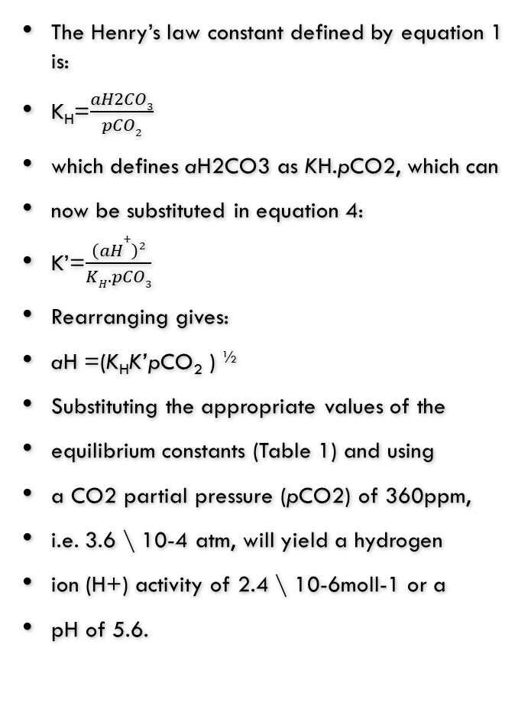
TEXT BOX-
Sulphur dioxide (SO2) is at much lower
activity in the atmosphere, but it has a
greater solubility and dissociation constant.
We can set equations analogous to those for
CO2:
aSO2(g) + aH2O ⬄aH2SO3(aq)
aH2SO3(aq) ⬄aH(aq) aHSO3 aq
and once again rearranging give
aH =(K_{H}K’pCO₂ ) ^{½}
If a small amount of SO2 is present in the air at an activity of 5 \ 10-9atm (not unreasonable over continental land masses), we can calculate a pH value of 4.85. So even low activity of SO2 can have a profound effect on droplet pH.
The Henry’s law constant defined by equation 1 is:
K_{H}=$\frac{aH2CO3}{pCO2}$
which defines aH2CO3 as KH.pCO2, which can
now be substituted in equation 4:
K’=$\frac{\left(aH+\right)2}{KH.pCO3}$
Rearranging gives:
aH =(K_{H}K’pCO₂ ) ^{½}
Substituting the appropriate values of the
equilibrium constants (Table 1) and using
a CO2 partial pressure (pCO2) of 360ppm,
i.e. 3.6 \ 10-4 atm, will yield a hydrogen
ion (H+) activity of 2.4 \ 10-6moll-1 or a
pH of 5.6.

Slide 110
.
Table 1 Henry’s law constants and first dissociation constants for atmospheric gases that undergo hydrolysis (25°C).
Gas | KH (mol l⁻¹ atm⁻¹) | K’ (mol l⁻¹)
Sulphur dioxide | 2.0 | 2.0 x 10⁻²
Carbon dioxide | 0.04 | 4.0 x 10⁻⁷

Slide 111
.
CHAPTER SUMMARY ATMOSPHERIC CHEMISRTY

Slide 112
ATMOSHERIC CHEMISTRY REVIEW QUESTIONS
What are the layers of the lithosphere? (3)
Mention the 5 Layers of the Atmosphere. (5)
The atmosphere is composed of a mixture of gases and particulates, mention 5 gases found in the atmosphere. (5)
How does temperature behave in the atmosphere? (2)
How does pressure behave in the atmosphere? (2)
The atmosphere can be broadly classified into two layers namely…...?(2)
What do you understand by partial pressure? (2)
What do you understand by resident time of gases in the atmosphere? (2)
Many trace gases in the atmosphere are in steady state. Explain? (2)
Steady state of atmospheric gases can be written by the equation F_{in} = F_{out} = A /r , Explain? (5)
The total atmospheric mass is 5.2 x 10¹⁸ kg. Given that Methane (CH₄) is 1.7ppm in the atmosphere and input into the atmosphere occurs at a rate of 500Tgyr-1 (i.e. 500 x 10⁹ kg yr-1). Calculate the resident time of CH₄ ignoring pressure and temperature effects? (6)

Slide 113
GEO-CHEMICAL SOURCES OF AIR REVIEW QUESTIONS
Sea salt is thought to an important source of ____ particles and_____gas. (2)
Complete the following reactions (2)
H₂SO₄(in aerosol) +NaCl(in aerosol) →
Mention 3 gases Volcanic gases or particulates (3)
The most important reactive entity in the lower atmosphere is a fragment of a water molecule, called _________ and higher up layers is _________.(2)
What is the radioactive source of Argon? (5)
What is the radioactive source of Helium? (5)
Mention 2 atmospheric gases or particulates from;
Forest fire (2)
Sea spray (2)
Fumarolic activity. (2)
Meteor (2)

Slide 114
BIOLOGICAL SOURCES OF AIR REVIEW QUESTIONS
Mention one biological sources of the following atmospheric gases or particulates. (10)
O₂ f. DMS
CO₂ g. OCS
NH₃ h. H₂S
NH₄ ⁻ i. CH₄
N₂0 g. CH₃Cl
Sea water is major source of nitrogen for the atmosphere. True/false
Iodine deficiency is called ______________ and is common____________
Mention the biological process and atmospheric gases produced from the following Equations: (12)
6H₂O + 6CO₂ → C₆H₁₂O₆ + 6O₂
C₆H₁₂O₆ + 6O₂ → 6CO₂ + 6H₂O + 38ATP
NH₂CONH₂(aq) +H₂O(l) → 2NH₃(g) +CO₂(g)
NH₃(g) + H(aq) → NH₄ ⁺(aq)
2NH₃(g) + 2O₂(g) → N₂O(g) +3H₂O(g)
C₆H₁₂O₆ + Yeast → 2C₂H₅OH + 2CO₂ + 2ATP.
How is HNO₃ formed in the atmosphere and give a reason of its importance. (2)
O₃ is an important gas normally found in the stratosphere, write 3 chemical equations of how recycled in the atmosphere. (2)
Write 3 compounds and destroy the O₃ layer. (3)

Slide 115
URBAN POLLUTION REVIEW QUESTIONS
Mention 2 types of air pollution that can occur in cites. (2)
Names 5 gases and/or particulates found in London Smog (b) Mention their sources. (5)
Names 5 gases and/or particulates found in Los Angeles Smog (b) Mention their sources. (5)
Mention 3 conditions necessary for smog to occur. (3)
What is mineral of Fe in the earth and fossil fuels. (2)
Write one health or environmental effect of the following gases of particulate found in smog. (6)
Ground O₃ e. PAN
PAH f. CO
SO₂ g. Toluene
C₆H₆ h. C
How is ground Ozone formed? (6)
Define the following terms (5)
Dust e. PM-₁₀
Particulate f. PM-_{2.5}
Aerosols

Slide 116
,
THE END
OF
PART 3

